Slide 1
Taxonomy Based Adaptive Search Engine
Praneeth Polavarapu

Slide 2
Motivation
Crawler Based Search engine
Noise in the Crawler Based search Engine is high
Search is limited to Locally Compiled Data Base
Efficiency of traditional search engine is low

Slide 3
Taxonomy Based Engine
Usage of rule based classifier based on machine learning technique.
Search is based on context selected by the user on the taxonomy
The main goal of this system is to deal with the exponential growth of data on web

Slide 4
The process
User’s query is modified based on the rule based classifier from documents from taxonomy based search engine
The modified query is then given input to crawler based search engine
The result set contains documents which can be categorized to a category in taxonomy.

Slide 5
Search is based on “learning” technique
Keywords are extracted from the results of taxonomy-based search engine and then based on that the query is modified and sent to the crawler.
This method assumes that both the crawler based and taxonomy based search engines process queries in Boolean form.

Slide 6
Query Formulation and Context Selection
Query is entered by the user with out specifying the context to the engine.
Based on the returned results the document can be classified as relevant or non relevant by the documents that are classified in the given context.
The classifier is designed to differentiate between relevant and non relevant categories

Slide 7
The classifier designed is dynamic because the classifier is designed based on the documents returned by the query where the documents are different from query to query
Ambiguity is removed by using the dynamic classifier.

Slide 8
Classifier
To classify a document a rule based classifier is used
These are set of rules of form T-> C where C is relevant or non relevant category
T is a conjunction of terms

Slide 9
Query modification
Let R ={r1,…,rn} is rule set of relevant category where ri = Ti-> Relevant
qi be T1 or…or Tn.
We modify query q by ANDing with qi

Slide 10
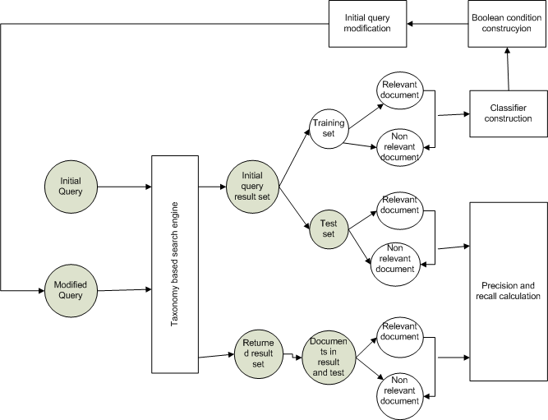
Experiment 1

Slide 11
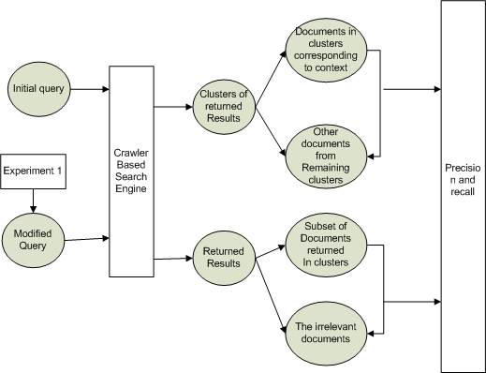
Experiment 2

Slide 12
Results
The results of this experiment is calculated by the parameter called precision.
The returned result set is more closely related to the user context eliminating the noise
This search engine does not fair well when the context is narrow.

Slide 13
Drawbacks
Its very hard to build a good and large hierarchical classifier that can deal with wide variety of topics.
This cannot deal with modification of category hierarchies. For ex: deletion and addition of categories and their associated documents.
This search engine is time consuming since it
takes multiple http requests to get the documents.

Slide 14
References
Taxonomy-based Adaptive Web Search Method
-Said Mirza Pahlevi and Hiroyuki Kitagawa

